Slide 1
Preparation for a web application
Jay Liu maxazure@gmail.com
Nathan Yin Nathan.yin@sit.ac.nz

Slide 2
Overview
Review of JavaScript
Environment installation
Bootstrap
React.js/umi-app

Slide 3

DOM Document Object Model
When a web page is loaded, the browser creates a Document Object Model of the page.
The HTML DOM model is constructed as a tree of Objects:

Slide 4
What is the HTML DOM?
The HTML DOM is a standard object model and programming interface for HTML. It defines:
The HTML elements as objects
The properties of all HTML elements
The methods to access all HTML elements
The events for all HTML elements
In other words: The HTML DOM is a standard for how to get, change, add, or delete HTML elements.

Slide 5
How JavaScript works with DOM
With the object model, JavaScript gets all the power it needs to create dynamic HTML:
JavaScript can change all the HTML elements in the page
JavaScript can change all the HTML attributes in the page
JavaScript can change all the CSS styles in the page
JavaScript can remove existing HTML elements and attributes
JavaScript can add new HTML elements and attributes
JavaScript can react to all existing HTML events in the page
JavaScript can create new HTML events in the page

Slide 6
JavaScript
What is JavaScript?
JavaScript is a programming language designed for Web pages.

Slide 7
Why Learn JavaScript?
JavaScript enhances Web pages with dynamic and interactive features.
Client side developer 3 MUST haves:
HTML to define the content of web pages
CSS to specify the layout of web pages
JavaScript to program the behavior of web pages

Slide 8
What Can JavaScript Do?
Common JavaScript tasks can replace server-side scripting.
JavaScript enables
shopping carts
form validation
Calculations
special graphic and text effects
image swapping
image mapping
Clocks
and more.

Slide 9
JavaScript Syntax.
Unlike HTML, JavaScript is case sensitive.
Dot Syntax is used to combine terms.
e.g. document.write("Hello World")
Certain characters and terms are reserved.
JavaScript is simple text (ASCII).

Slide 10
JavaScript Terminology.
Understanding JavaScript terms is fundamental to understanding the script.
Objects
Properties
Methods
Events
Functions
Values
Variables
Expressions
Operators

Slide 11
Objects
Objects refers to windows, documents, images, tables, forms, buttons or links, etc.
Objects should be named.
Objects have properties that act as modifiers.

Slide 12
Properties
Properties are object attributes.
Object properties are defined by using the object's name, a period, and the property name.
e.g. background color is expressed by: document.bgcolor.
document is the object.
bgcolor is the property.

Slide 13
Methods
Methods are actions applied to particular objects. Methods are what objects can do.
e.g. document.write(”Hello World")
document is the object.
write is the method.

Slide 14
Events
Events associate an object with an action.
e.g., the OnMouseover event handler action can change an image.
e.g., the onSubmit event handler sends a form.
User actions trigger events.

Slide 15
Functions
Functions are named statements that performs tasks.
e.g. function doWhatever () {statement here}
The curly braces contain the statements of the function.
JavaScript has built-in functions, and you can write your own.

Slide 16
Values
Values are bits of information.
Values types and some examples include:
Number: 1, 2, 3, etc.
String: characters enclosed in quotes.
Boolean: true or false.
Object: image, form
Function: validate, doWhatever

Slide 17
Variables
Variables contain values and use the equal sign to specify their value.
Variables are created by declaration using the var command with or without an initial value state.
e.g. var month;
e.g. var month = April;

Slide 18
Expressions
Expressions are commands that assign values to variables.
Expressions always use an assignment operator, such as the equals sign.
e.g. var month = May; is an expression.
Expressions end with a semicolon.

Slide 19
Operators
Operators are used to handle variables.
Types of operators with examples:
Arithmetic operators + - * /
Comparisons operators == === >= <=
Logical operators &
Control operators if
Assignment and String operators = += -= *= /=

Slide 20
Methods of Using JavaScript.
1. JavaScripts can reside in a separate page.
2. JavaScript can be embedded in HTML documents -- in the <head>, in the <body>, or in both.
3. JavaScript object attributes can be placed in HTML element tags.
e.g. <body onLoad="alert('WELCOME')">

Slide 21
1. Using Separate JavaScript Files.
Linking can be advantageous if many pages use the same script.
Use the source element to link to the script file.
<script src="myjavascript.js”
language="JavaScript1.2”
type="text/javascript">
</script>

Slide 22
2. Embedding JavaScript in HTML.
When specifying a script only the tags <script> and </script> are essential, but complete specification is recommended:
<script type="text/javascript">
<!-- Begin hiding
window.location=”index.html"
// End hiding script-->
</script>

Slide 23
Using Comment Tags
HTML comment tags should bracket any script.
The <!-- script here --> tags hide scripts in HTML and prevent scripts from displaying in browsers that do not interpret JavaScript.
Double slashes // are the signal characters for a JavaScript single-line comment.

Slide 24
3. Using JavaScript in HTML Tags.
Event handler like onMouseover is a perfect example of an easy to add tag script.
<a href=”index.html”
onMouseover="document.logo.src='js2.gif'"
onMouseout="document.logo.src='js.gif'">
<img src="js.gif" name="logo">
</a>

Slide 25
4. CALLING FUNCTIONS ON EVENT
A JavaScript function is executed when "something" invokes it (calls it).
<script type="text/javascript">
function myfunction(){
alert("hi");
}
</script>
<button onclick="myfunction()">Click Me</button>

Slide 26
Three Must Know methods
alert()
prompt()
confirm()

Slide 27
Using the alert() Method
You can use it to display textual information to the user (simple and concise).
The user can simply click “OK” to close it.

Slide 28
Using the alert() Method
function myfunction(){
alert("An alert triggered by JavaScript");
var num = 10;
alert(num);
}

Slide 29
Using the confirm() Method
This box is used to give the user a choice either OK or Cancel.
It is very similar to the “alert()” method.
You can use it to ask user for true or false input.
You can also put your message in the method.

Slide 30
Using the confirm() Method
function myfunction(){
confirm("Are you happy with the class?“);
}

Slide 31
Using the confirm() Method
function myfunction(){
if (confirm("Are you happy with the class?"))
document.write(":)");
else
document.write(":(");
}

Slide 32
Using the prompt() Method
This is the only one that allows the user to type in his own response to the specific question.
You can give a default value to avoid displaying “undefined”.

Slide 33
Using the prompt() Method
function myfunction() {
prompt("What is your student id number?");
prompt("What is your name?","NoName");
}

Slide 34
Using the prompt() Method
function myfunction() {
var age = prompt("How old are you?");
var name = prompt("What is your name?","NoName");
document.write("My name is " + name + ", I am " + age + " years old.“
);

Slide 35
What is Bootstrap?

Slide 36
Bootstrap
Bootstrap is a popular UI framework
Bootstrap is the most popular HTML, CSS, and JS framework for developing responsive, mobile first projects on the web.

Slide 37
Features
CSS resetting for cross browser compatibility
Grid scaffolding for design
Multi-screen support (responsive design)
Mobile first
And a really good looking UI framework

Slide 38
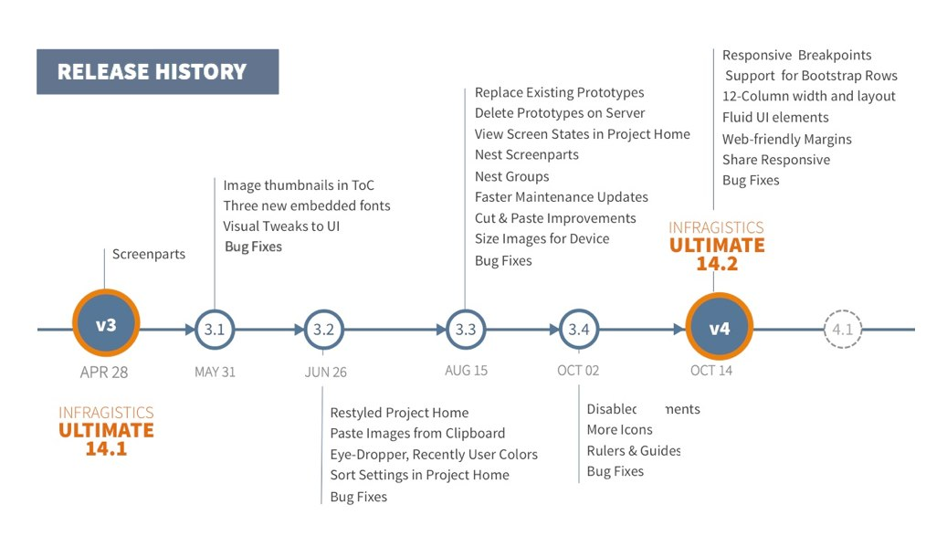
Bootstrap Versions

Slide 39
Bootstrap Versions
In this course, we will be working with
Bootstrap 4.1.3

Slide 40
Bootstrap Installation

Slide 41
Bootstrap Installation
Download CSS and JS
Download Source Files
Reference Bootstrap CDN
Other options

Slide 42
Bootstrap Installation Download CSS and JS
Simply download the precompiled Bootstrap CSS and JavaScript files.
This works well if you need to install a copy of Bootstrap that will work even without an internet connection

Slide 43
Bootstrap Installation Download Source Files
This way is to downloadall of the files that the developers used to create Bootstrap, which includes everything including the original sass files and the documentation.
You only want to do this if you want to contribute to the project, or customize Bootstrap.
We won't be talking about this option in this course.

Slide 44
Bootstrap Installation CDN
CDN stands for Content Delivery Network
CDN is a place that hosts common libraries like Bootstrap.
Advantage: Speed
Bootstrap code is saved on the user’s computer in cache.
http://www.bootstrapcdn.com/

Slide 45
Bootstrap Other options
NuGet manager in Visual Studio.
Composer in PHP
Bower
Etc.
These are advanced installations that make it easier to work with package managers, and help you work with more complex projects.
We won’t be using them in this course.

Slide 46
Bootstrap
Now to get instructions and to download a copy of Bootstrap manually, you can go to this URL.
https://getbootstrap.com/docs/4.1/getting-started/download/

Slide 47
Bootstrap Dependencies
Bootstrap requires jQuery and tether
jQuery is a fast, small, and feature-rich JavaScript library.
http://jquery.com/download/
Tether is a JavaScript library for efficiently making an absolutely positioned element stay next to another element on the page.
http://tether.io

Slide 48
Q & A
What is Bootstrap?
What are the installation methods for Bootstrap?

Slide 49
Bootstrap Using Basic Styles

Slide 50
Overview
Basic Styles
Typography
Typography utilities
Blockquotes and lists
Bootstrap Colors
Work with Images
Q&A

Slide 51
Basic Styles

Slide 52
Browser Styles
Without Bootstrap, developers usually write their own CSS to override Browser styles.
Browser Styles
Custom CSS

Slide 53
Bootstrap Styles
The Bootstrap CSS styles are going to go between browser styles and your own styles to provide changes that make things look better.
Browser Styles
Bootstrap CSS
Custom CSS

Slide 54
Reboot
Reboot makes styles consistent across different browsers and platforms
In Reboot
1 rem == 16px

Slide 55
Basic Typography

Slide 56
Basic Typography
Reboot.css styles
Normalize styles so they look similar in different devices and browers
Rems vs Ems
Bootstrap uses Rems, a font measurement system that makes it easier to control both the size of fonts across the entire platform, and within individual components.
Avoid margin-top
You will have to add spacing at the top
Margins are only placed at the bottom

Slide 57
Basic Typography
Inherit when possible
It helps when you write your own CSS on top of Bootstrap CSS.
You won't have to work as hard to override styles.
Border-box sizing
Makes it easier to calculate the width of elements
For example, you specify that an element like a div is 200 pixels wide, and then you specify 10 pixel padding, the box is still going to be 200 pixels wide. It's not going to add the extra padding,

Slide 58
Typographic Utilities Classes
text-justify
sets the text of a paragraph or any other element fit to the edge of left and right with the same amount of spacing
text-nowrap
allows you to run text infinitely to one side without actually cutting it off at the edge

Slide 59
Typographic Utilities Classes
text-xx-pos
xx
sm>576px
md>768px
lg>992px
xl>1200px
pos
left
center
right
Examples
text-center
text-md-left
text-sm-right

Slide 60
Typographic Utilities Classes
text-lowercase
text-uppercase
text-capitalize

Slide 61
Text Styles
font-weight-bold
font-weight-normal
font-italic

Slide 62
Blockquotes and lists

Slide 63
Blockquotes
blockquote
blockquote-reverse
Blockquote footer
blockquote-footer on div inside blockquote tag
Example
<blockquote class="blockquote blockquote-reverse">
During the summer, our rabbit, Tonto, began to have severe redness and itching on his belly and feet. I'm very thankful to the
<div class="blockquote-footer">
Jane
</div>
</blockquote>

Slide 64
Lists
list-unstyled
No bullets
Inline Lists
list-inline on ul
list-inline-item on each li

Slide 65
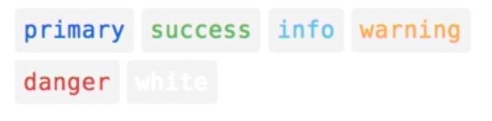
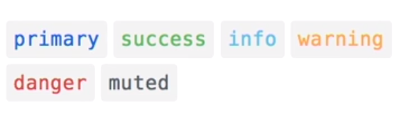
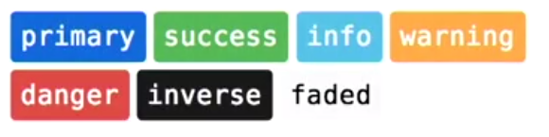
Colors
text-COLOR for text
Use for links
bg-COLOR

Slide 66
Work with images

Slide 67
Basic Imagee
img-fluid responsive images
image adjusts to the width of the container
rounded round edges, rounded-DIR
top right bottom left
circle
rounded-0
img-thumbnail rounded 1px border

Slide 68
Aligning images
Images are inline elements by deafult
float-left or float-right
text-center
center inline image
mx-auto
If image is defined as block element image

Slide 69
Figures
figure on the <figure> tag
figure-img on the images
figure-caption on the text

Slide 70
Q & A
In Bootstrap, what is the purpose of Reboot?
Bootstrap avoids margin on what direction?
What is the number pixels md represents In Bootstrap?
How do you make an inline style list?
How do you make text red using Bootstrap built-in text colours?

Slide 71
Bootstrap Mastering Layout

Slide 72
Overview
The grid system
Containers and rows
Multiple columns
Offset columns
Nested columns

Slide 73
The grid system
Responsive 12-column
Bootstrap uses a 12-column grid system that has breakpoints for extra small, small, medium, large, and extra large devices
Containers
Rows/Columns
The Bootstrap grid gives you a framework to create any layout that you can think of.

Slide 74
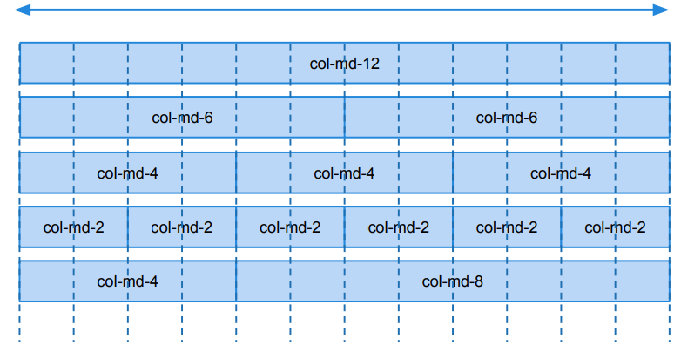
The grid layout
12 column row

Slide 75
Containers and rows

Slide 76
Containers
container
center content and snap to certain grid points.
container-fluid
Takes the full width of the viewport, which means the width of the device or the browser window
15px padding
15 pixel padding on each side to make sure container works well with backgrounds and other elements
Adjusts to breakpoints
xs,sm,md,lg,xl

Slide 77
Columns
12 Column Grid
You decide how contents fits into those
Columns can span
columns span just an Excel spreadsheet
specify when the layout converts to a full horizontal layout

Slide 78
Columns
col-BP-COL
Break Points
sm > 576px
md > 768px
lg > 992px
xl > 1200px
Control when columns go full width
COL
1-12
Specify how much of the space the column takes
With more than one column, Bootstrap will automatically size them to fit into the space

Slide 79
Columns Example
col-md-6
The column stays fully horizontal until it reaches the medium breakpoint, 768 pixels
The column will take up 6of the 12 units which is half of the space
col-6
The column will always try to be six of the units at every one of the different sizes

Slide 80
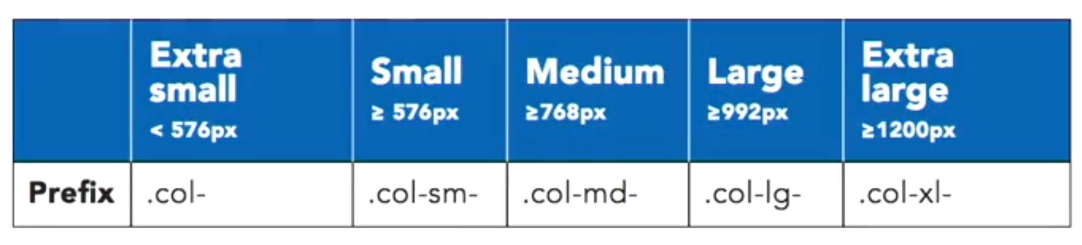
Multiple-columns
Specify multiple-column breakpoints for each of our grid elements
Use more than break point to specify a grid that adjusts and does different things at different breakpoints

Slide 81
Multiple-columns Example
https://getbootstrap.com/docs/4.0/examples/grid/

Slide 82
Offsetting Columns
offset-BP-COL
Break Points
sm > 576px
md > 768px
lg > 992px
xl > 1200px
COL
1-11
Use offset columns to move their position on the grid

Slide 83
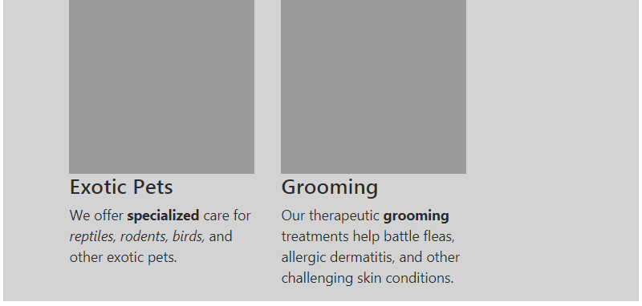
Offsetting Columns Example
<section class="col-sm-4 off-set-1">
</section>
<section class="col-sm-4">
</section>

Slide 84
Nesting Columns
row inside column
Creates 12-col grid
To nest columns, create a new row inside an existing column.
Use same classes

Slide 85
Nesting Columns Example
<div class="row">
<section class="col-sm-8"> </section>
<section class="col-sm-4">
<div class="row">
<section class="col-sm-8"> </section>
<section class="col-sm-4"> </section>
</div><!– nested row -->
</section>
</div><!-- row -->

Slide 86
Q & A
Bootstrap uses _____ columns grid system.
What's the best way to nest columns using Bootstrap?
What pixel size does md represent?

Slide 87
Bootstrap Forms

Slide 88
Overview
Basic form
Checkboxes & Radio Inputs
Multicolumn forms
Input groups

Slide 89
Bootstrap Basic Form Classes
Bootstrap has some fantastic classes to help you build forms.

Slide 90
Bootstrap Basic Form Classes
form-group
It’s used on block element like fieldsets and divs and adds a bit of spacing to the bottom of the element.
It sets the group to display block.
And it's required for proper layout of some elements.
form-text
It’s used on paragraphs and text that belongs underneath input fields.

Slide 91
Bootstrap Form Controls
form-control
It’s used on input fields like text input box, select and text areas.
form-control-label
It’s used on labels belonging to form controls.
form-control-file
specifically for file inputs

Slide 92
Bootstrap Form Controls Example
<div class="form-group">
<label class="form-control-label" for="petname">Pet name</label>
<input class="form-control" type="text" id="petname" placeholder="Your Pet's name">
</div>

Slide 93
Bootstrap Checkboxes & Radio Inputs
There are a number of styles that are geared towards checkboxes and radio input fields.
They're a little bit different than normal input fields because their layouts are different.

Slide 94
Bootstrap Checkboxes & Radio Inputs
form-check
It doesn't go inside the input fields themselves, but instead on a container for the form elements.
form-check-label
It is specifically for the labels that belong to these type of fields
form-check-input
It is for the checkbox or radio button input field itself
Checkboxes and radio buttons display as block elements by default.
If you want them to display side-by-side, you can use form-check-inline.

Slide 95
Checkboxes & Radio Inputs Example
<div class="form-check form-check-inline">
<label class="form-check-label">
<input class="form-check-input" type="radio" name="spayneut" value="yes" checked> Yes
</label>
</div><!-- form-check -->
<div class="form-check form-check-inline">
<label class="form-check-label">
<input class="form-check-input" type="radio" name="spayneut" value="no"> No
</label>
</div><!-- form-check -->

Slide 96
Bootstrap Multicolumn Forms
Bootstrap helps you lay out forms using the column grid. There's a few classes you should know about.
Form styles
Needs container
Use rows cols
col-form-label
gives labels a better spacing inside form elements that are inside columns

Slide 97
Q & A
What type of input fields can be applied class form-control?
What class make form input fields side-by-side?

Slide 98
Bootstrap Navigation

Slide 99
Overview
Navigation Components
Basic navigation menu
Narbar
Branding & Text

Slide 100
Navigation Components
Navs
The parents to all the other components
Tabs & Pills
Type of component and help you create content within a page that changes when clicked
Navbars
Main navigation between pages

Slide 101
Navigation Components Features
Branding
Color schemes
Dropdowns
Form elements
It's rare that a project will use all the features available

Slide 102
Basic Nav Classes
With/without ul
nav
nav-item
nav-link

Slide 103
Nav Link Options
active
Link shows up as active with the look depending on the style
disabled
Link is disabled and shows as grey out link

Slide 104
Nav Styles
nav-pills
Links looks like a little button with round edges
nav-tabs
Link looks like tabs

Slide 105
Nav Alignment
Used on nav tag to align components
justify-content-center
Center components
justify-content-end
Right align components
nav-fill
Make the links fit the horizontal space
The space of each link is depending on the content, and the width of the text
nav-justified
Force the space in between each element to be the same, no matter the length of the text

Slide 106
Basic Navigation Bar Example
<ul class="nav">
<li class="nav-item">
<a class="nav-link" href="#">Home</a>
</li>
<li class="nav-item">
<a class="nav-link" href="#">About</a>
</li>
<li class="nav-item">
<a class="nav-link" href="#">Contact</a>
</li>
</ul>

Slide 107
Basic Navigation Bar With tabs style
<ul class="nav nav-tabs">
<li class="nav-item">
<a class="nav-link active" href="#">Home</a>
</li>
<li class="nav-item">
<a class="nav-link" href="#">About</a>
</li>
<li class="nav-item">
<a class="nav-link disabled" href="#">Contact</a>
</li>
</ul>

Slide 108
Basic Navigation Bar nav Example
<nav class="nav nav-tabs">
<a class="nav-item nav-link active" href="#">Home</a>
<a class="nav-item nav-link" href="#">About</a>
<a class="nav-item nav-link disabled" href="#">Contact</a>
</nav>

Slide 109
Basic Navigation Bar With alignment
<nav class="nav nav-tabs justify-content-center">
<a class="nav-item nav-link active" href="#">Home</a>
<a class="nav-item nav-link" href="#">About</a>
<a class="nav-item nav-link disabled" href="#">Contact</a>
</nav>

Slide 110
Navbar classes
navbar
Main container of the navigation menu
navbar-toggleable-BP
BP - Break opint
xs sm md lg xl
navbar-nav
Containes links to your navigation

Slide 111
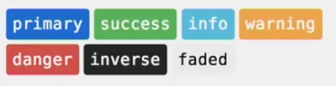
Navbar Colors
bg-COLOR
color the navbar itself
navbar-light
light text color
navbar-inverse
used for dark background color such as inverse

Slide 112
navbar-nav Options
nav-item
nav-link
active
disabled

Slide 113
navbar Example
<nav class="navbar navbar-toggleable-sm bg-faded navbar-light">
<div class="navbar-nav">
<a class="nav-item nav-link active" href="#">Home</a>
<a class="nav-item nav-link" href="#">About</a>
<a class="nav-item nav-link disabled" href="#">Contact</a>
</div>
</nav>

Slide 114
Branding & Text
Branding is used for text or logos that get an enhanced look.
With navbar text component, you can add in-line text that works with the rest of the navigations.

Slide 115
Branding & Text Navbar Options
navbar-brand
used inside a navbar at the same level as the navbar-navlinks
Link or Headline
Using Images
Image size often needs adjusted
navbar-text
Allow text into the navigation with the best possible allignment.

Slide 116
navbar-brand with Text Example
<nav class="navbar navbar-inverse bg-primary navbar-toggleable-sm">
<div class="container">
<a href="" class="navbar-brand">Bootstrap Lab</a>
<div class="navbar-nav">
<a class="nav-item nav-link active" href="#">Home</a>
<a class="nav-item nav-link" href="#">Gallery</a>
<a class="nav-item nav-link" href="#">About</a>
<a class="nav-item nav-link" href="#">Contact Us</a>
</div><!-- navbar-nav -->
</div><!-- container -->
</nav>

Slide 117
navbar-brand with Image Example
<nav class="navbar navbar-inverse bg-primary navbar-toggleable-sm">
<div class="container">
<a href="" class="navbar-brand">
<img src="images/wisdompetlogo.svg" style="width:80px" alt="" />
Bootstrap Lab
</a>
<div class="navbar-nav">
<a class="nav-item nav-link active" href="#">Home</a>
<a class="nav-item nav-link" href="#">Gallery</a>
<a class="nav-item nav-link" href="#">About</a>
<a class="nav-item nav-link" href="#">Contact Us</a>
</div><!-- navbar-nav -->
</div><!-- container -->
</nav>

Slide 118
navbar-text Example
<nav class="navbar navbar-inverse bg-primary navbar-toggleable-sm">
<div class="container">
<div class="navbar-nav">
<a class="nav-item nav-link active" href="#">Home</a>
<a class="nav-item nav-link" href="#">Gallery</a>
<a class="nav-item nav-link" href="#">About</a>
<a class="nav-item nav-link" href="#">Contact Us</a>
</div><!-- navbar-nav -->
<span class="nav-text">addtional info on navbar</span>
</div><!-- container -->
</nav>

Slide 119
Q & A
What class is the parent to all the components in Bootstrap navigation?
What class is used to force the space between the elements to be the same?

